Slide 1
Chronic Kidney Disease Prediction using Adaboost Classifier
Guided by Mr .M M Meera Durga
Team C12
P.Niharika Y20ACS538
V.Joshna Florence Y20ACS583
B.Gowtham Y19ACS416
S.Mohan Y20ACS572

Slide 2

ABSTRACT
EXISTING SYSTEM
PROPOSED SYSTEM
DESIGN
IMPLEMENTATION
RESULTS
CONCLUSION
CONTENTS

Slide 3
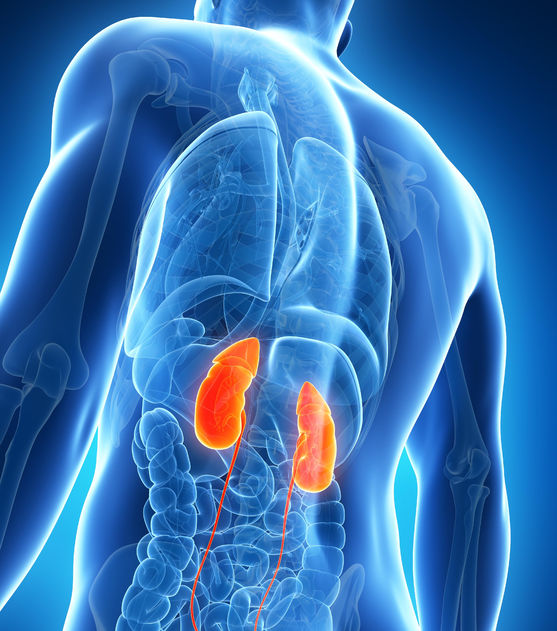
ABSTRACT
Since last three decades, Kidney has been emerged as major chronic diseases, impacting the health of all age human being and may cause several other diseases if it is untreated and unidentified.
To cope with such problems and address the challenges of healthcare, a wide range of tools, techniques and frameworks have been offered by Machine Learning as it has the capability of determining and recognizing patterns in complex datasets.
In this project, an efficient Ensemble classifier based advanced Machine Learning approach that is Adaboost Classifier has been proposed for the diagnosis of associated risk factors, cofactors promoting its progression, complications in prevention and control of CKD.

Slide 4
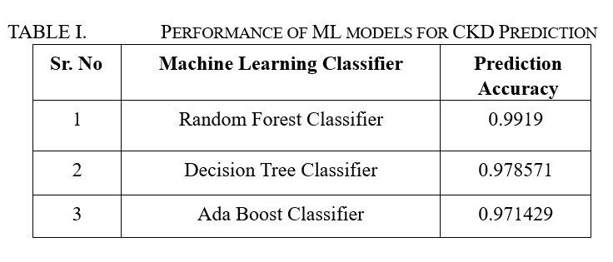
EXISTING SYSTEM
The existing system aims to determine the most accurate model for predicting chronic kidney disease (CKD) by assessing various machine learning algorithms' predictive capacities.
The research compares the performance of three ml algorithms-Random forest, Adaboost and Decision tree classifier.
To enhance prediction accuracy, researchers used cross-validation techniques, such as K-Fold Cross-Validation which has a drawback of increased training time and potential data leakage leading to overestimated performance.

Slide 5
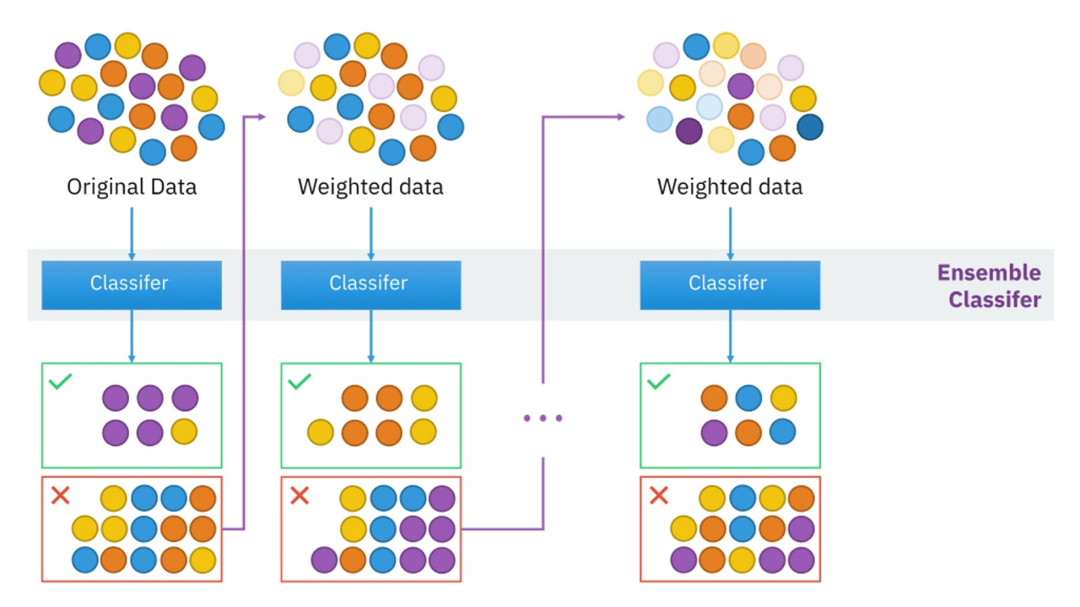
PROPOSED SYSTEM
The proposed system aims to further enhance Chronic Kidney Disease (CKD) prediction by implementing an AdaBoost Classifier trained on preprocessed medical data
Adaptive Boosting, is an ensemble machine learning algorithm that can be used in a wide variety of classification and regression tasks. It is a supervised learning algorithm that is used to classify data by combining multiple weak or base learners (e.g., decision trees) into a strong learner.
It demonstrated promising performance with high accuracy of 98.3 on both training and testing datasets
Performance metrics such as accuracy, confusion matrix, and classification report are computed to assess the model's effectiveness in CKD prediction.

Slide 6
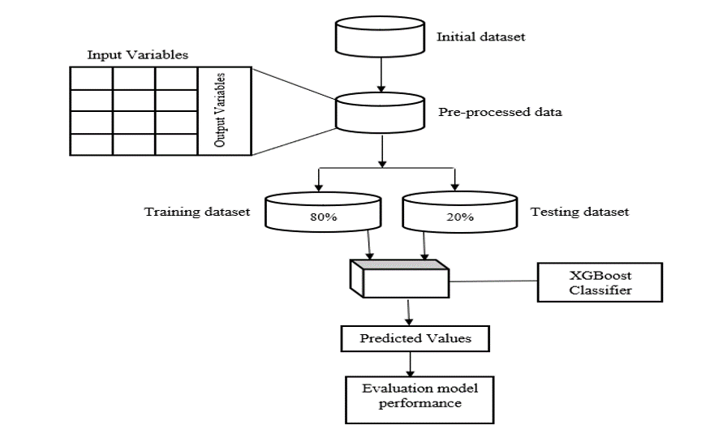

DESIGN
Adaboost classifier

Slide 7
IMPLEMENTATION
Data Collection:
Dataset is collected from Kaggle website and it must be in structured format like csv file or excel.
Data Pre-processing:
It is the important step in prediction models. It involves cleaning of collected data.
Data Splitting:
The preprocessed data is often split into training and testing sets.
Model Training and Testing:
Train an AdaBoost classifier on the training data and then test it.
Model Evaluation:
Evaluate the performance of your model using evaluation metrics like accuracy,precision,recall..etc.,
Deployment:
Once satisfied with the model’s performance, deploy it in a real world setting.

Slide 8
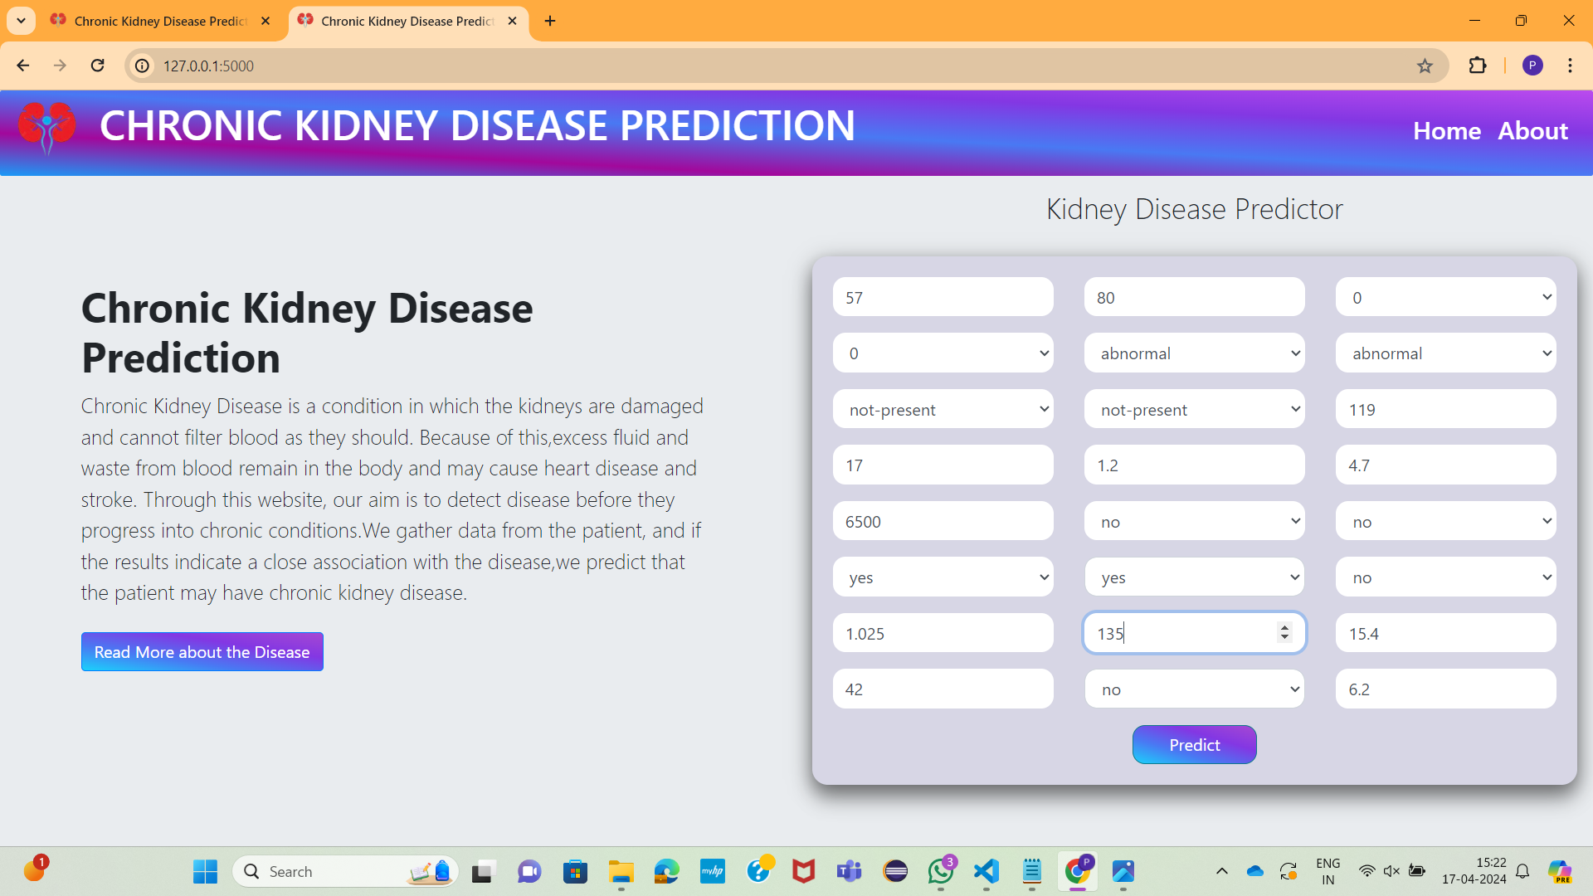
RESULT
The website takes input from the user for details such as age, sugar levels, blood pressure, etc.

Slide 9
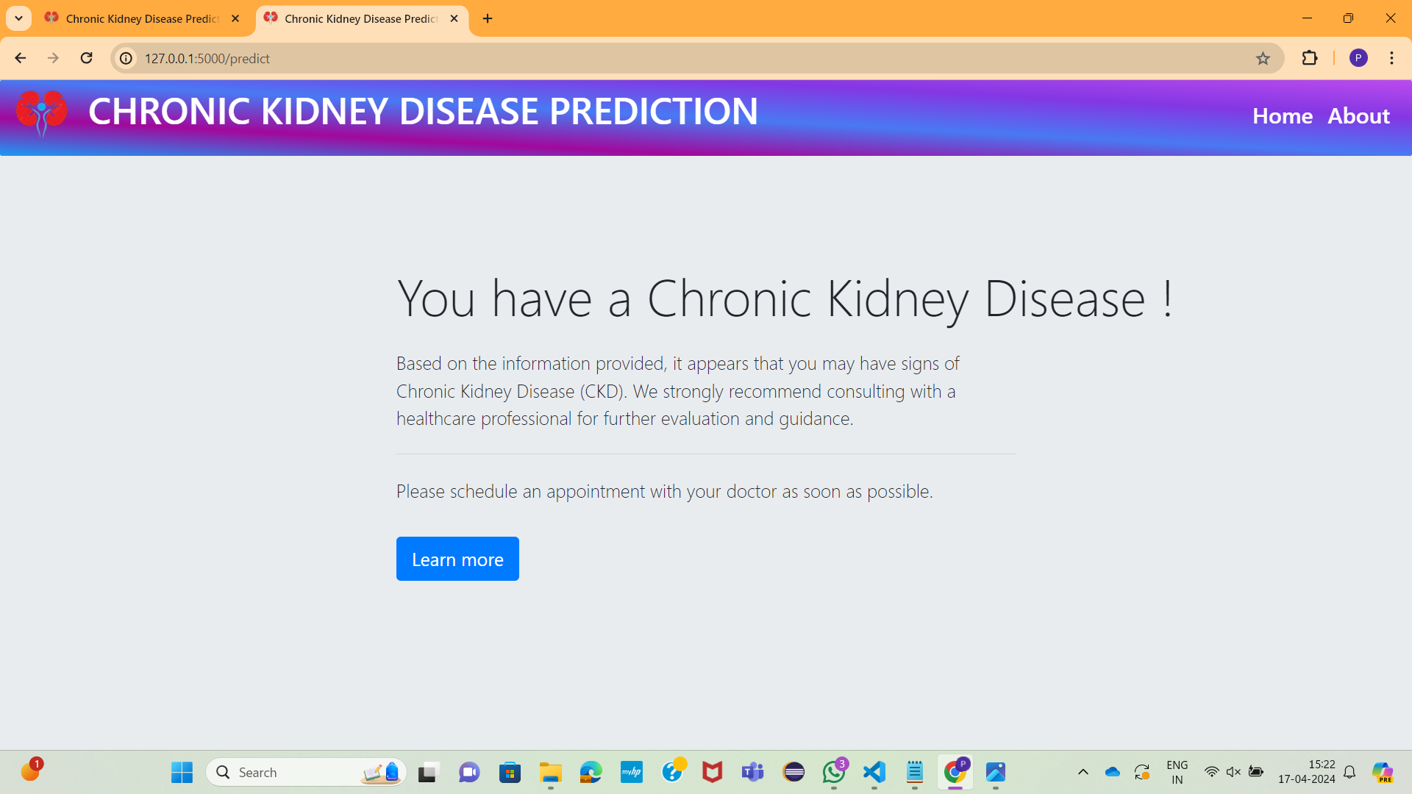
If the entered details closely match the indicators of chronic kidney disease, the website displays a message advising the patient to consult a doctor. If not, it indicates that the patient does not have kidney disease.

Slide 10
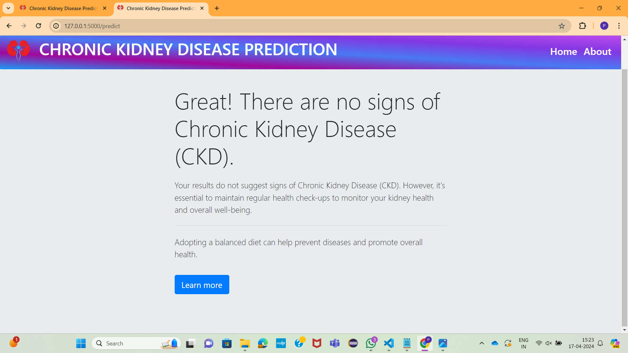

Slide 11

CONCLUSION
In conclusion, early detection of Chronic Kidney Disease (CKD) is crucial for effective management. This study examined the effectiveness of the Adaboost classifier in predicting CKD, revealing promising performance. These findings underscore the potential of machine learning algorithms to assist doctors in the early detection and prediction of CKD. By leveraging such technologies alongside promoting healthy lifestyle choices, we can empower individuals to take proactive steps towards maintaining kidney health and overall well-being.

Slide 12
Thank You

